Slide 1



ICTC Training program

Slide 2
Versioning
Version | Date de version | Auteur / Contributeurs | Nature des modifications
2.0 | 2017-03-20 | Carolandrea Guerrero Mickaël Brard Julien Jézéquel-Bréard | Diffusion initiale

Slide 3
Inventory Management

Slide 4
Outcomes
Manage multiples warehouses and locations,
Create routes and picking waves ,
Track items within kits and bundles at the product level,
Control inventory across sales channels (receiving, issuing, and moving of stock),
Planning and replenishment products.

Slide 5
Inventory Strategies
Supply Chain & Inventory Strategies
1. Product / Material & Transport
2. Warehouse Operations
3. Warehouse Optimization
4. Logistics Performance
Delivery Order
Raw material to manufacture
Incoming Shipments
Inventory Levels /
Valuation Methods
Stocks Methods
Procurement Strategy
Distribution Networking
Planning
Return Management
Supplier Evaluation
Optimal Supply Chain
Reducing delivery time
Reducing storage
Optimize Distribution costs
Optimize workforce costs
Optimize quality
Optimize facilities &
equipment
Lean Warehousing
Wave Management
Location Management
Sub-Assembly and Kitting
Zones
Cross-Docking
Labor Outsourcing
Reverse Logistics /
Back-Haul

Slide 6







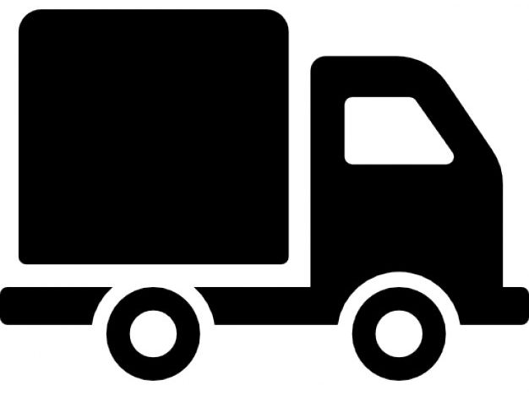
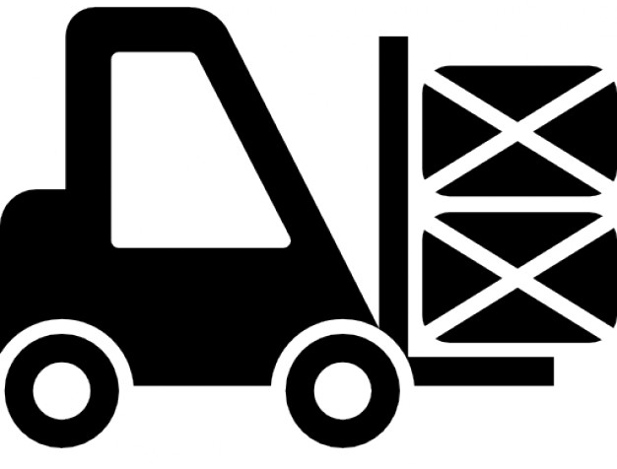



Inventory
Warehouse Management
Location Management
Picking & Packing
Shipping Operations
Inventory Management
Barcode System

Slide 7






Inventory – Process Overview
Suppliers
Raw Materials
&
Components
Warehouse
Finished Products
Shipping
Production
Quality Check

Slide 8




Inventory – Stock Allocation
Sales
Channels
In-Store
Market Places &
E-Commerce
Mobile
B2B
Def. - Inventory item not yet withdrawn from the storage but reserved for a specific purpose, and therefore unavailable for other purposes*.
Equal Stock Allocation – Each sales channel will have same stock quantity.
Trend Stock Allocation – It is based on sales numbers of each sales channel.
Universal Stock Allocation – The same volume of stock for all sales channel.
http://www.businessdictionary.com/definition/allocated-stock.html

Slide 9
Internal logistics

Slide 10

Warehouse Process – Operations Type
1
Receiving
2
Put - away
3
Storage
Schedule carrier
Unload Vehicle
Inspect for damage
Identify Product
Identify Product Location
Move products
Update records
Equipment
Stock Location
4
Order Picking
5
Shipping Preparation
6
Shipping
Information
Walk & Pick
Batch Picking
Packing
Labeling
Stacking
Schedule Carrier
Load vehicle
Bill of Loading
Record Update

Slide 11
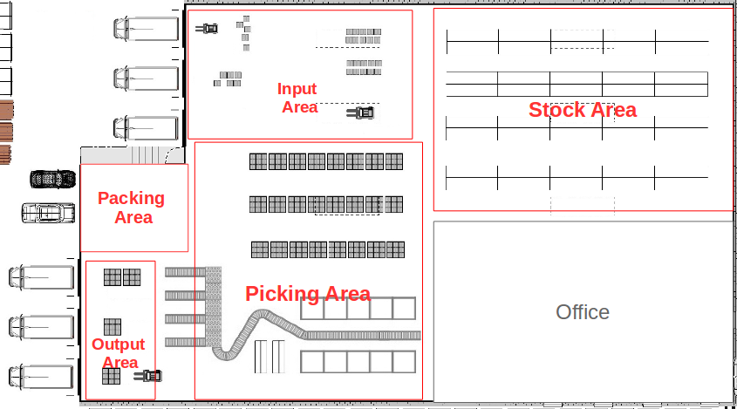
Warehouse vs. Location
It is building/place in which items are stocked.
Warehouse
It is a specific space within the warehouse.
There are 3 types of locations :
- Physical Location – Internal location that is part of the warehouse. It can be the loading and unloading area, a shelf or a department, etc.
- Partner Location – Space within a customer and/or vendor’s warehouse. You are not the owner of the warehouse.
- Virtual Location – place does not exist, but in which products can be placed when they are not physically in an inventory yet (Procurements), Inventory loss, etc.

Slide 12
Exercise : Settings Warehouse
20 min
Canadian Colors would like to transfer the set of brushes to its point of sales « Color Stores ». Before, they must register the Color Stores as warehouses.
TO DO
Select manage several Warehouses with several stock locations option in settings inventory module.
Setting warehouses

Slide 13
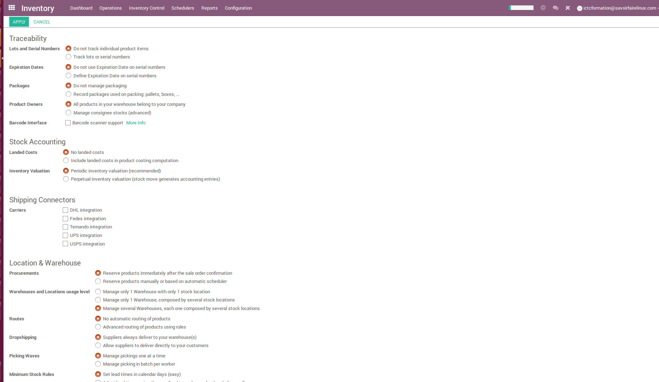
Inventory – Locations & Warehouses
Settings Location & Warehouse Manage several Warehouses, each one composed by several stock locations

Slide 14
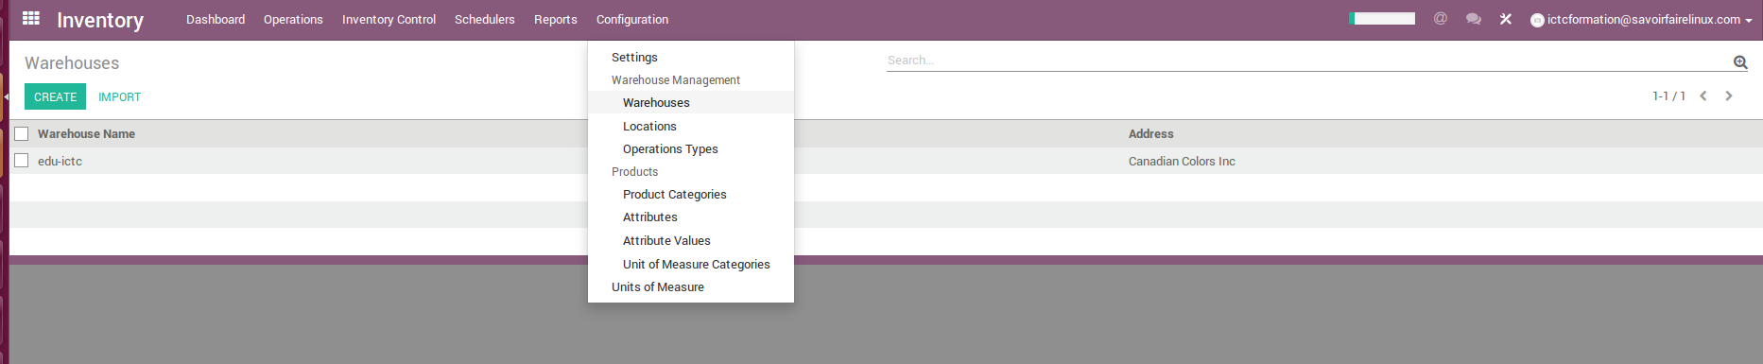
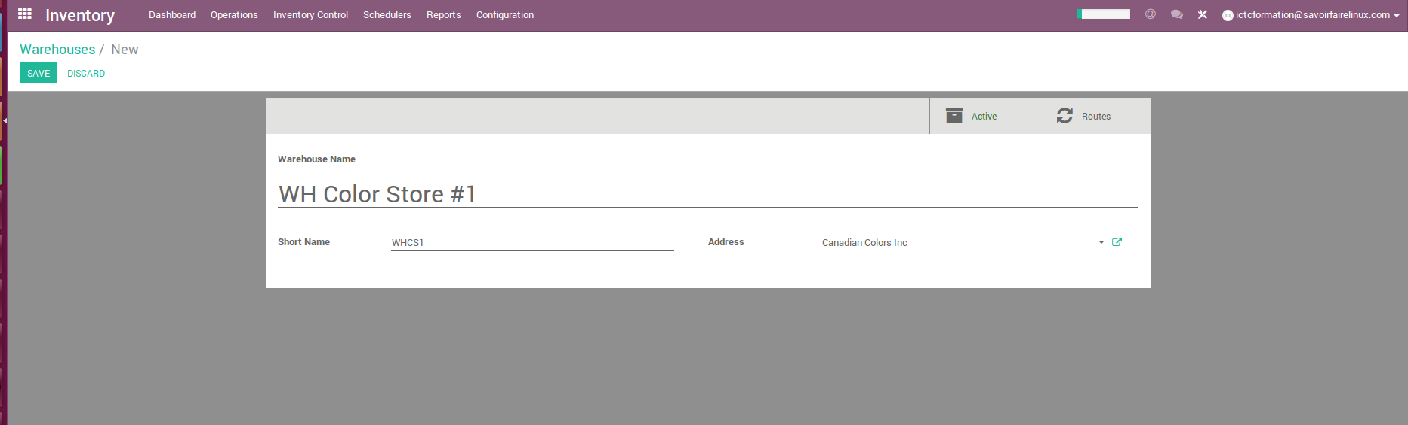
Inventory – Settings Warehouses

Slide 15
Inbound logistics

Slide 16
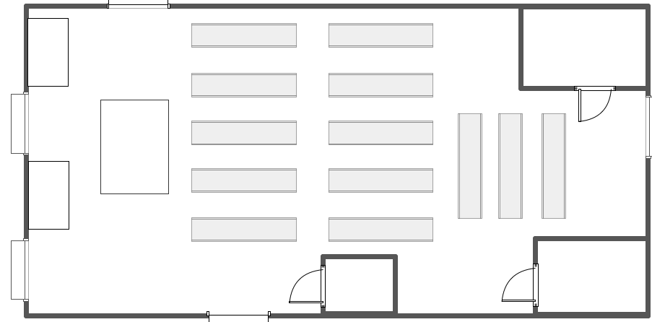
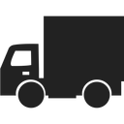
Incoming Shipments
1
Receipt & Stock
One step – Receive products directly in stock. Companies having small warehouse wich does not require a high stock of items or does not sell perishable items. For example, according to the product type, the stock could be the standard type of storage or the floor storage.
Input Area
Stock Area
(Standard Shelf)

Slide 17
Incoming Shipments
2
Load Splitting
Stock
Two steps – Unload products in input location before going to stock. Screening and sorting processes before going to stock.
Input
Area
Stock Area
(Standard Shelf)
Load
Splitting

Slide 18
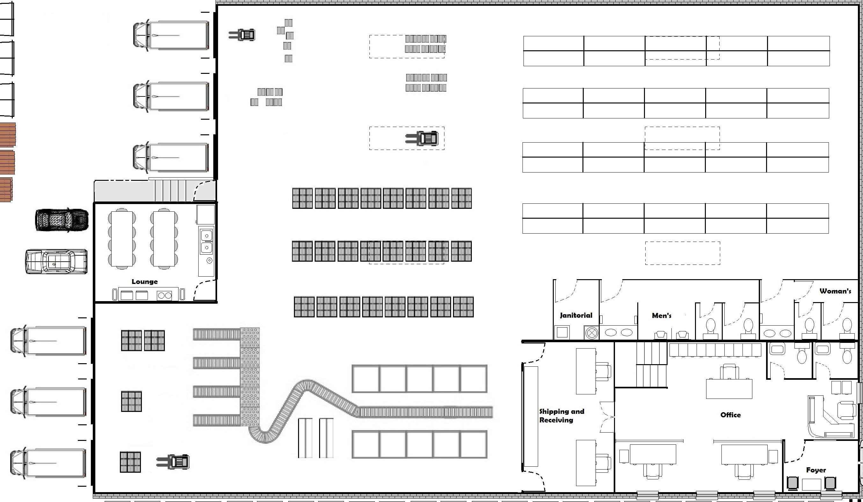
Incoming Shipments
3
Unload
Quality Control
Stock
Three steps – Unload in input location, go through a quality control before being admitted in stock.
Input Area
Stock Area
Quality
Control
Area
Office

Slide 19
Outbound logistics

Slide 20
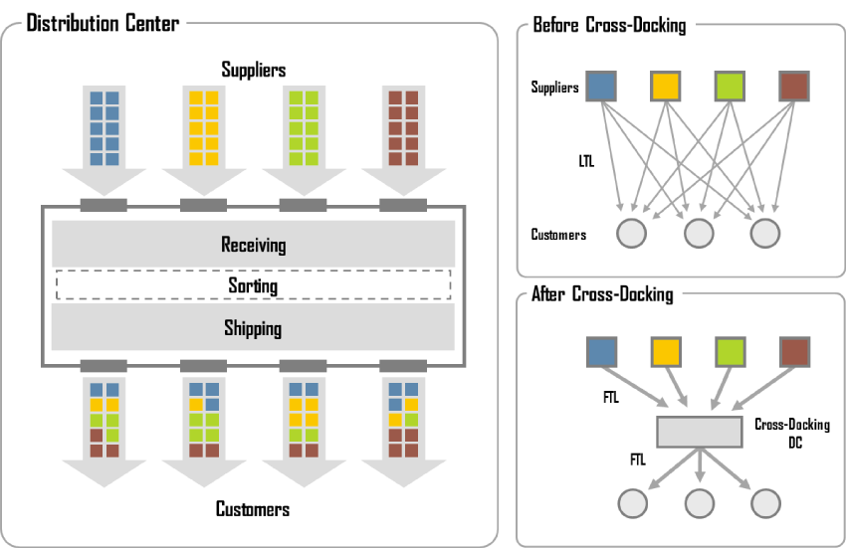
Outgoing Shippings
1
Shipping
One step – Ship directly from stock (ship only). Cross docking manages products with docking area where product directly places from supplier location and transfers this to gate pass for customer delivery.
Order items by weight, size, quantity, and location
Screening & Sorting

Slide 21
Outgoing Shippings
2
Quotation
Pick
Ship
Two steps – Bring goods to output location before shipping. Inventory methods such as FIFO, LIFO, and FEFO require having at least two steps to handle a shipment.
Stock Area
Picking Area
Office
Output
Area

Slide 22
Outgoing Shippings
3
Pick
Pack
Ship
Three steps – Make packages into a dedicated location, then bring them to the output location. Mainly used for handling very large stocks.
Stock Area
Picking Area
Packing
Area
Office
Output
Area

Slide 23
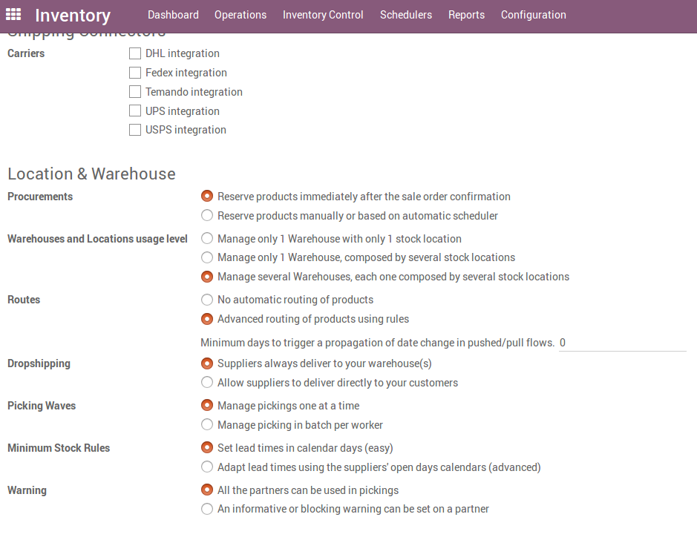
Inventory – Location Configuration

Slide 24
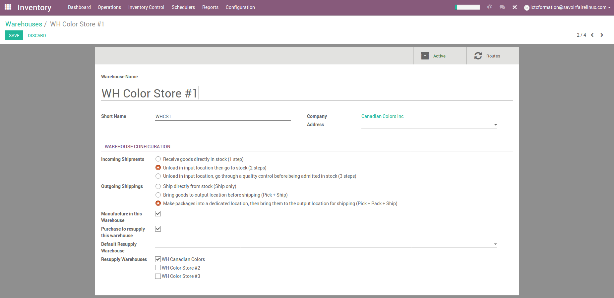
Inventory – Location Configuration
WH Canadian Colors will be resupply warehouse for all stores
According to Incoming Shipment and Outcoming Shipping selection, the system creates the warehouse locations and operations types in the system by default.

Slide 25
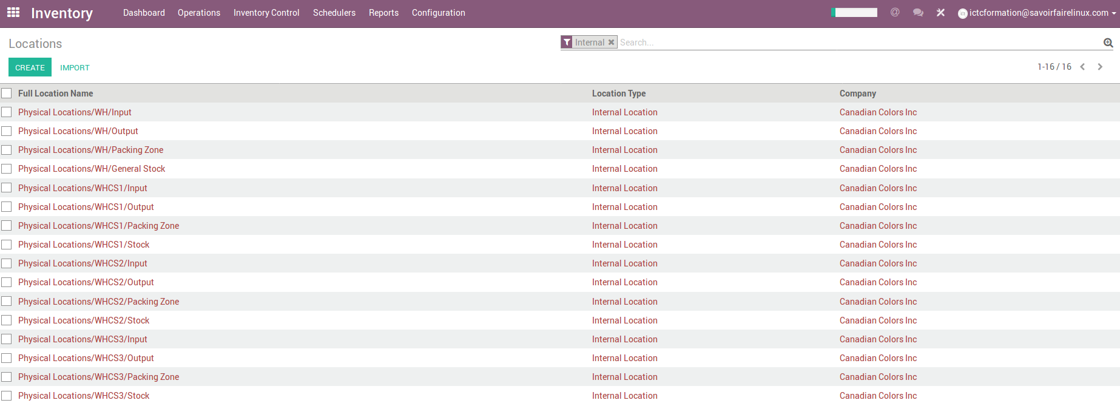
Inventory – Location Configuration
Warehouse locations by default :

Slide 26
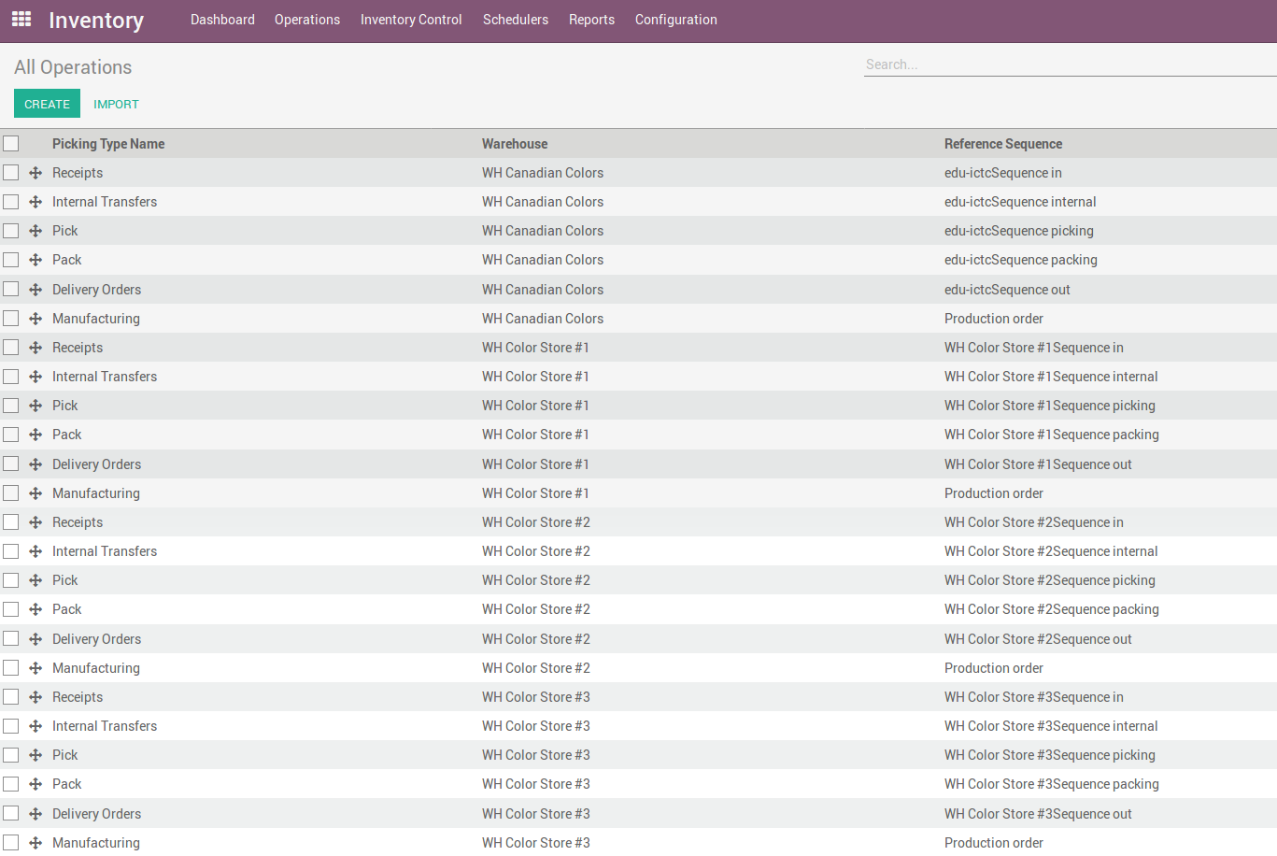
Inventory – Operations Types
Operations Types by default :

Slide 27
Exercise : Warehouse Configuration
15 min
TO DO
According to the warehouse layout (WH Canadian Colors), set up the incoming shipments in 2 steps ( unload in input location before going to stock) and the outcoming Shippings in 3 steps (Pick + Pack + Ship).
For stores, set up the product reception directly in stock and the outcoming Shippings in 2 steps (Pick + Ship).
The warehouse (WH Canadian Colors) will be the resupply warehouse for stores.

Slide 28
Exercise : Delivery Orders (pick + pack + ship)
30 min
TO DO
Take « Paintcolor » customer and create a sales order of 200 units of any product.
For this customer, edit two (2) delivery addresses (Only Ontario). 100 units of the product will be delivered for each destination.
Make the delivery taking the following flow of stock moves between locations :
WH/Stock WH/Packing Zone WH/Output Final Destination

Slide 29
Logistics Strategies

Slide 30
Exercise : Locations & Logistic Strategies
Canadian Colors would like to set up its logistic strategies only for its main warehouse (Physical Locations/WH/Stock). To do this, you must consider the following information :
The company has divided its stock according to the type of product :
As Removal Strategy, the FIFO accounting will be the method chosen by the company to manage warehouses, inventory, and stock.

Slide 31
Exercise : Locations & Logistic Strategies
15 min
TO DO
Take in « Locations » - Physical Locations/WH/Stock – and change the location name as « General Stock ».
According to the information above, set the Removal and Put Away Strategies for this location.
Create the Location « Mezzanine » and set the logistics strategies for this location as well.

Slide 32
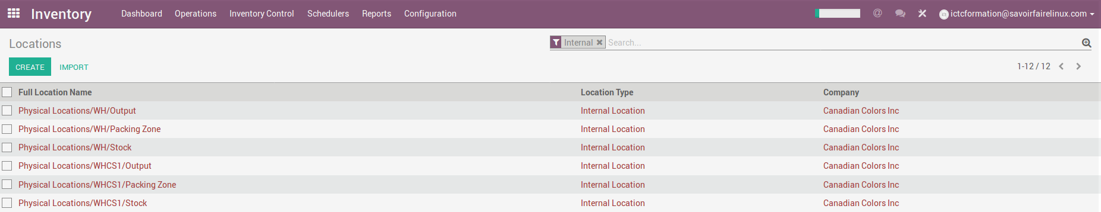
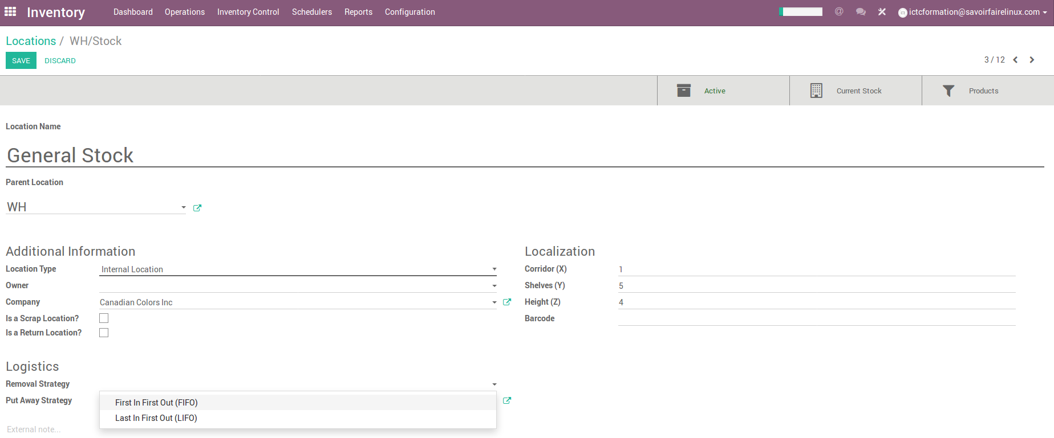
Inventory – Location & Logistics Strategies
Stock Method

Slide 33
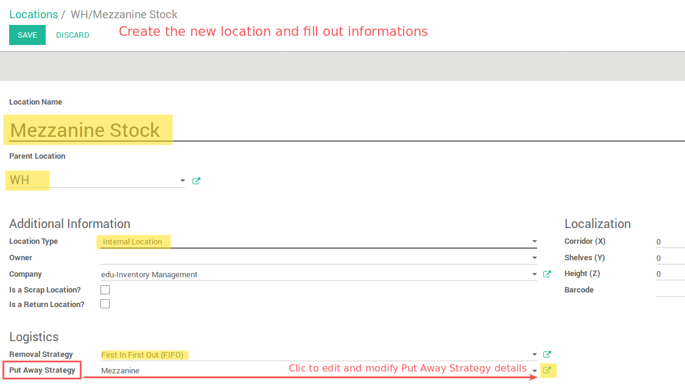
Inventory – Location & Logistics Strategies

Slide 34
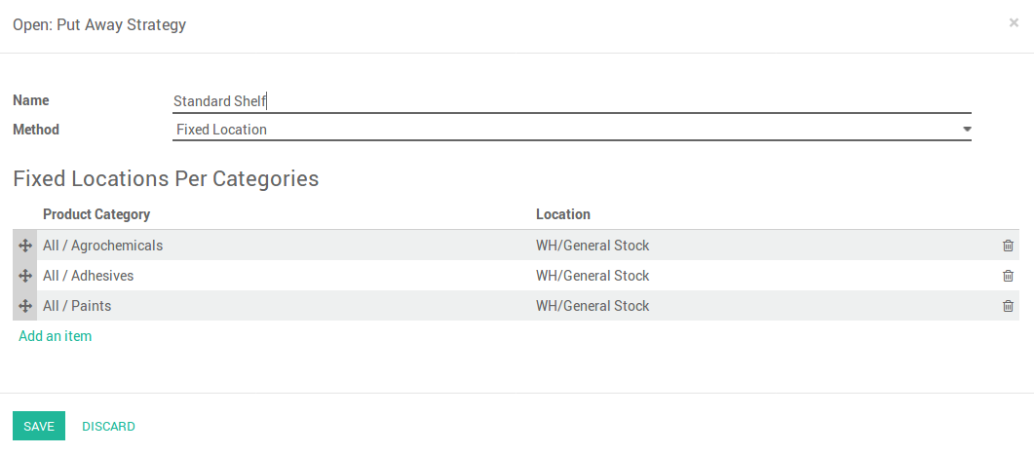
Inventory – Location & Logistics Strategies

Slide 35
Inter-warehouse transfers

Slide 36
Exercise : Inter-warehouse transfers
60 min
Canadian Colors would like to transfer the set of brushes to its point of sales « Color Stores ». According to the following distribution rules:
Create internal transfers per store. From the dashboard, select an internal movement of one of the two warehouses. The route to apply :
WH/General Stock WH/Output WHCS1/Input WHCS1/Stock
Pay attention taking the physical locations by the warehouse to make the transfers.

Slide 37
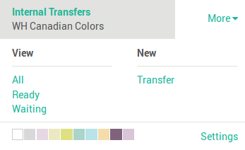
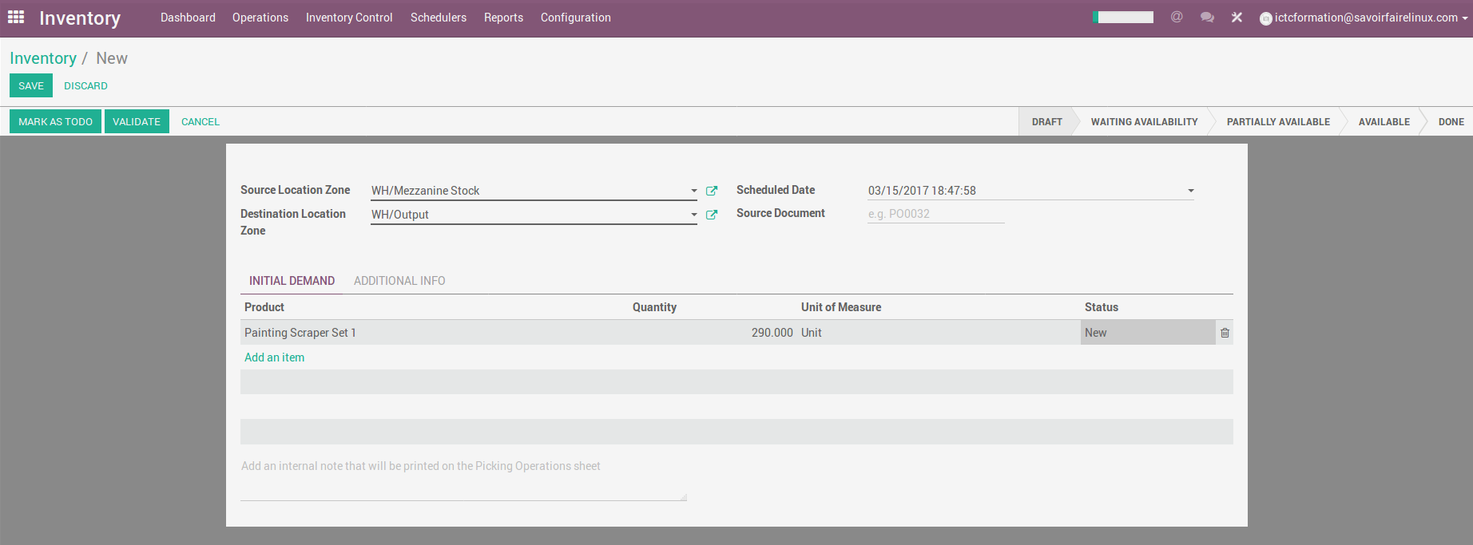
Internal Transfers (Mezzanine - Output)
Inventory Dashboard Internal Transfers
If you select Valide, Odoo will process all quantities to transfer.
If you select Mark as TODO, Odoo will put the transfer in Waiting Availability status. Click on Reserve to reserve a number of products in your source warehouse.

Slide 38
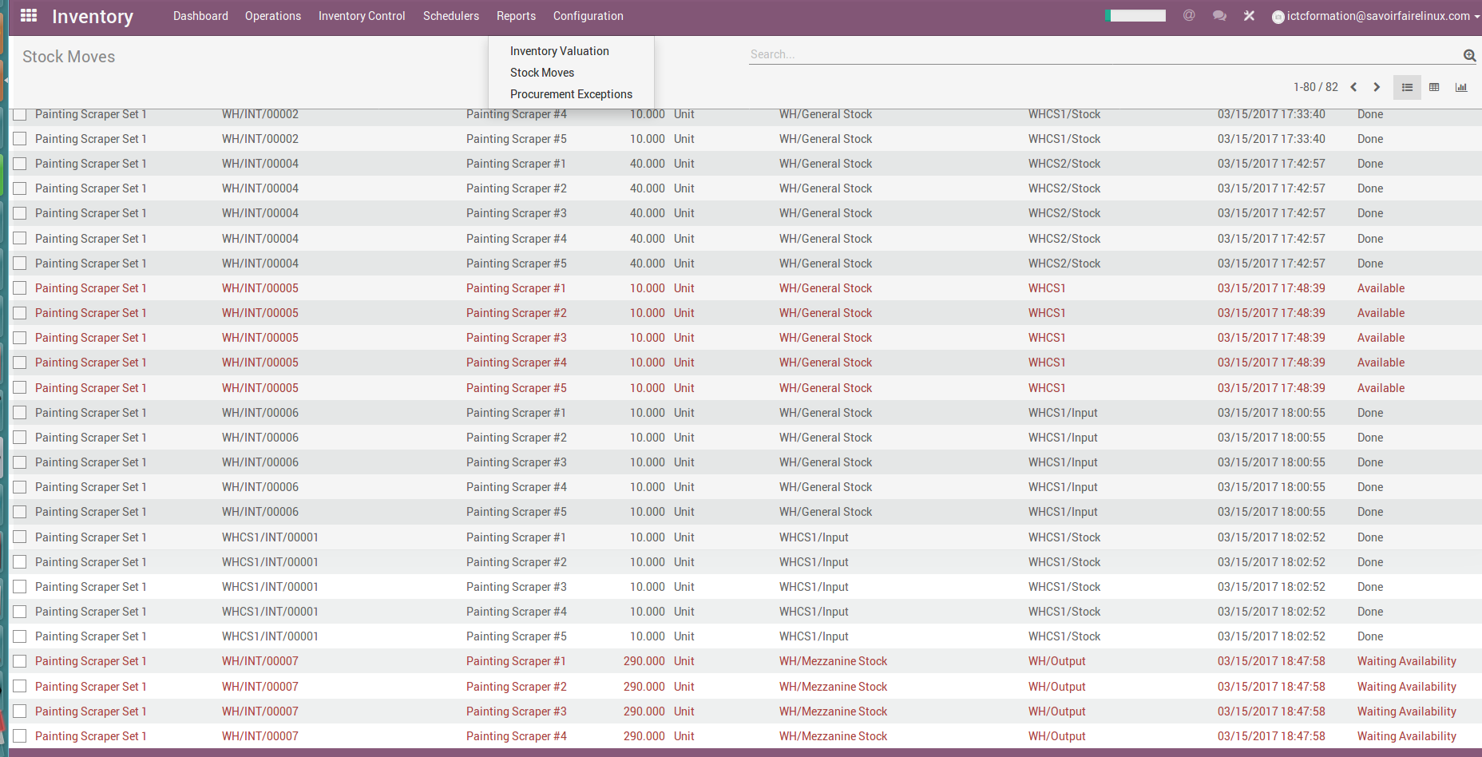
Inventory – Stock Moves

Slide 39
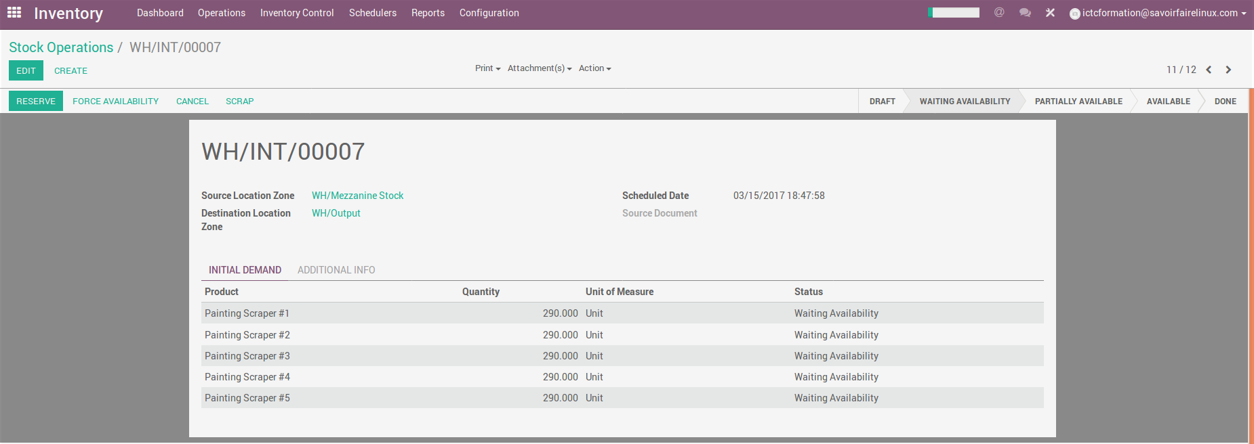
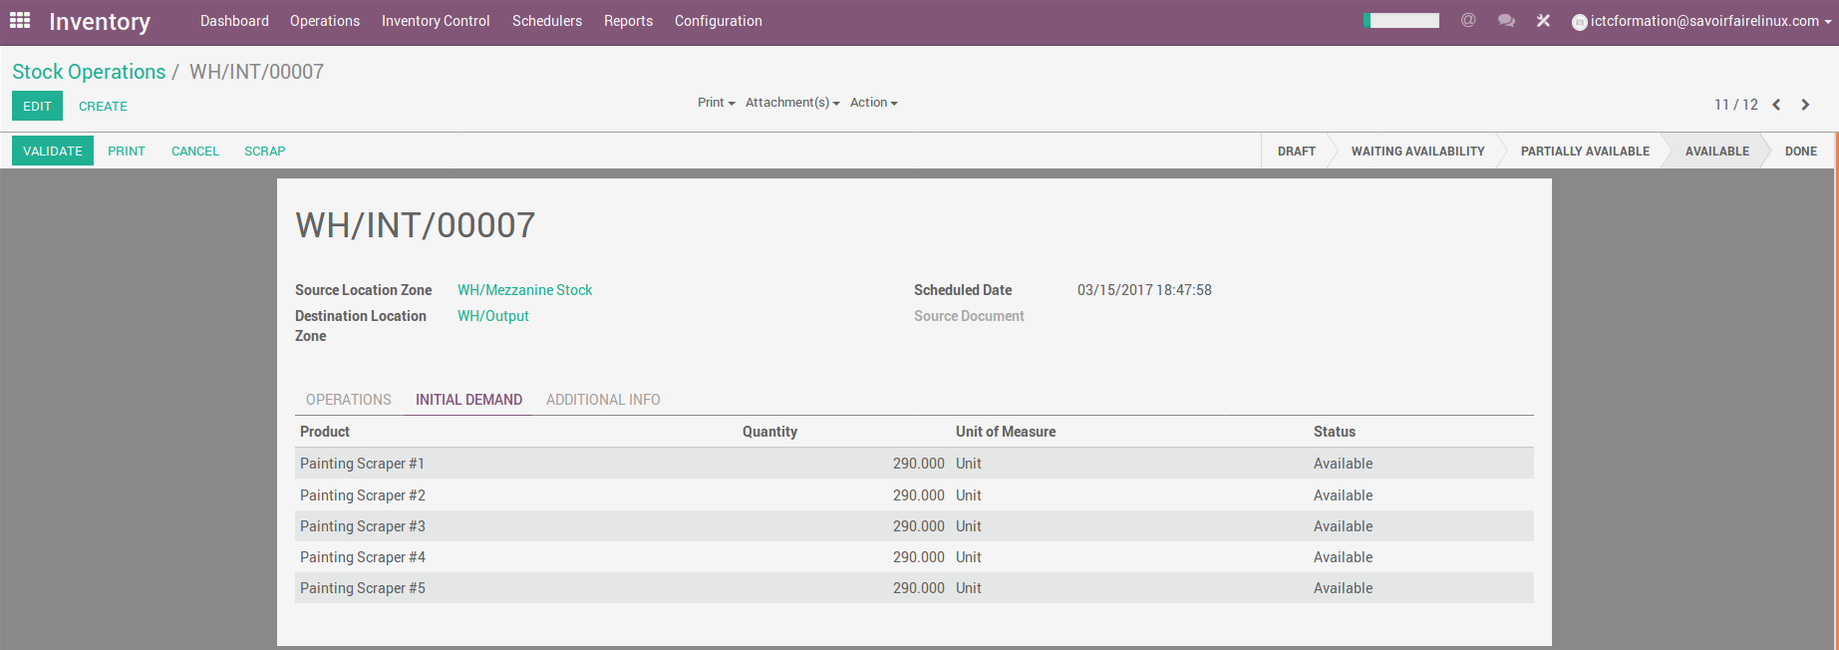
Internal Transfers (Mezzanine - Output)

Slide 40
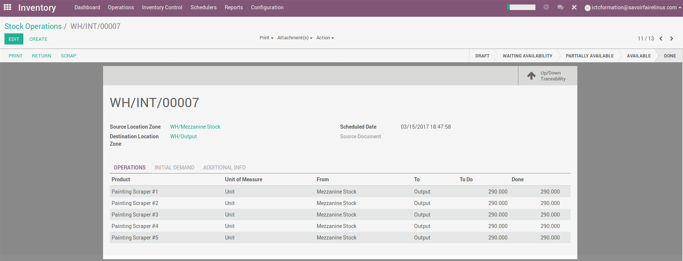
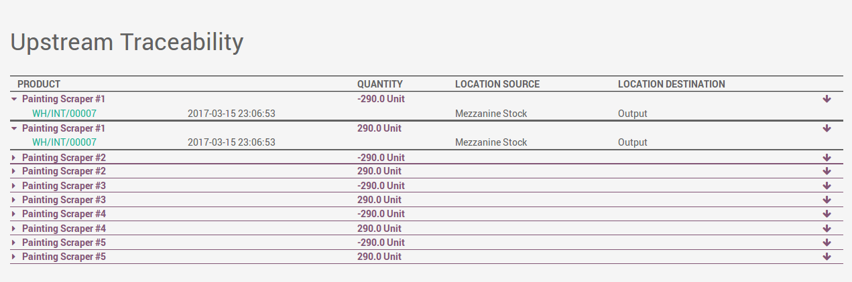
Internal Transfers - Traceability

Slide 41
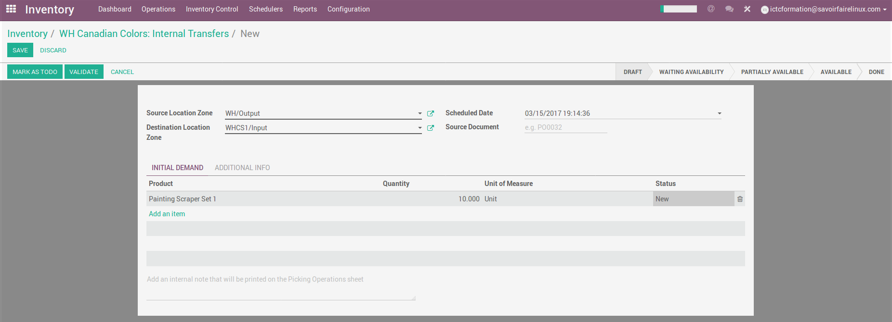
Internal Transfers (WH/Output – Store/Input)

Slide 42
Omni-channel Fulfillment

Slide 43
Fulfillment Operations for Omni-Channel
The complete process from point of sales inquiry to delivery of a product to the customer.

Slide 44
How to use « drop-shipping »
Orders will be shipped straight from suppliers to customers
Only for products that you can not or do not want to keep in stock
For niche products. For example, products with high demand and are being offered by large suppliers
Although you do not handle the direct delivery, you should provide customers a tracking number.

Slide 45
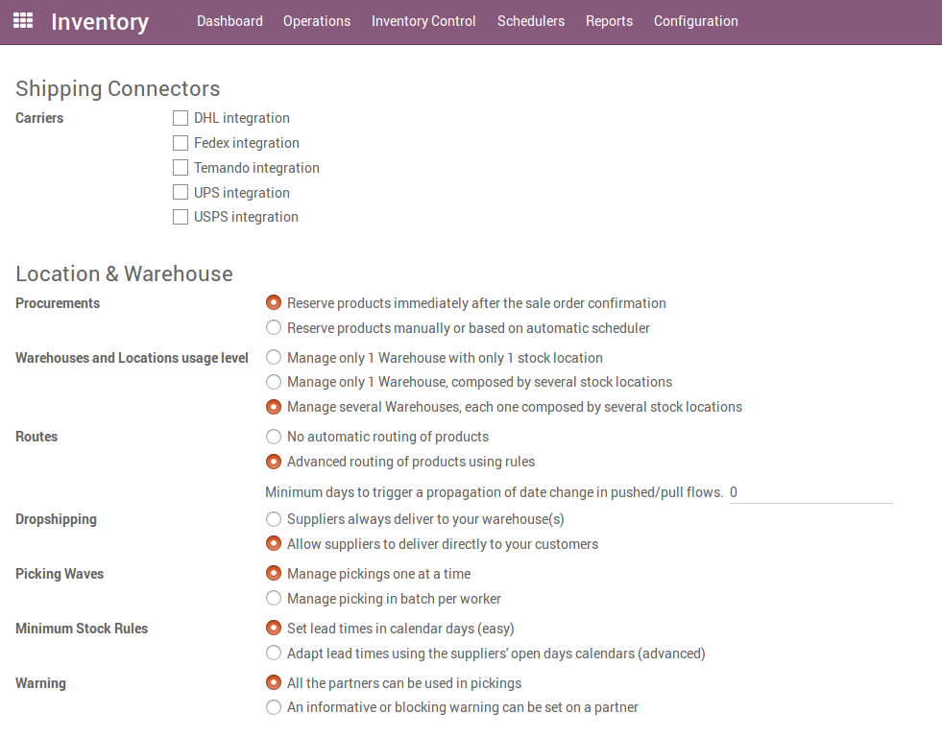
Configuring drop-shipping

Slide 46
Exercise : Delivery from supplier to customer directly
30 min
TO DO
Create the product « Scaffolding » which is provided by « Turbo Inc ». Due to the extra dimension of this product, the supplier is responsible for making the direct delivery to customers. Sale price 1.200$CAD
Add « Turbo Inc » as the supplier for this product
Select Drop-shipping as logistics route
Create a sales order for this product. Choose an existing customer or create a new one if you want
Confirm the sending from the vendor to the customer, go back to INVENTORY app. On the dashboard, click on TO RECEIVE on the drop-ship card.

Slide 47
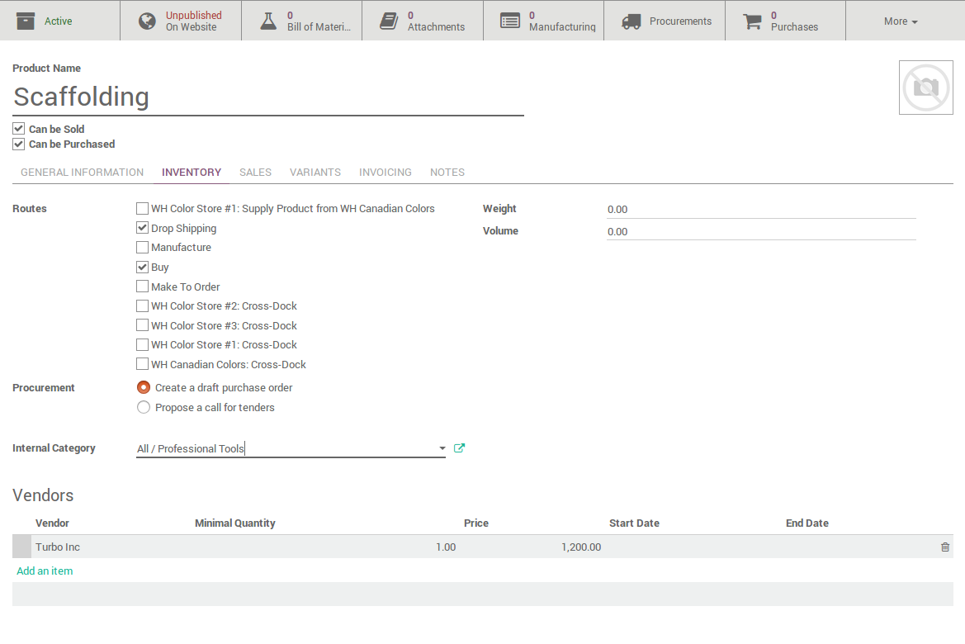
Drop-shipping product

Slide 48
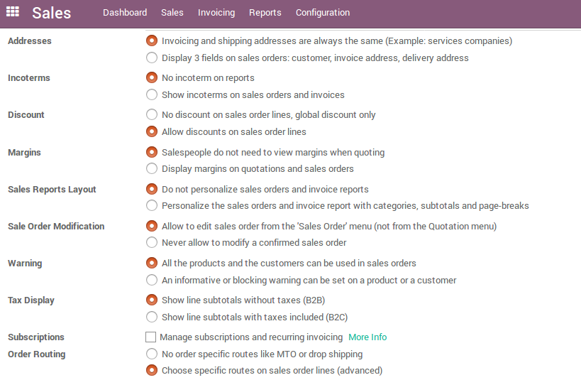
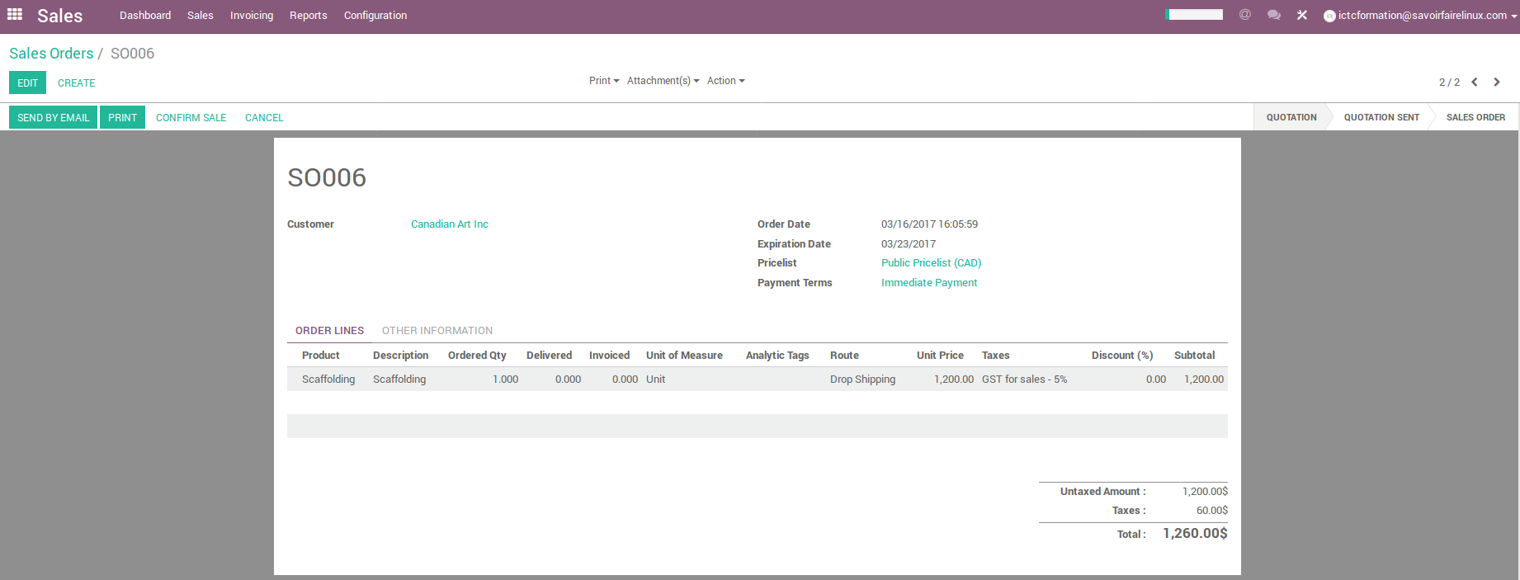
Drop-shipping sales order

Slide 49
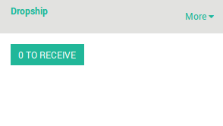
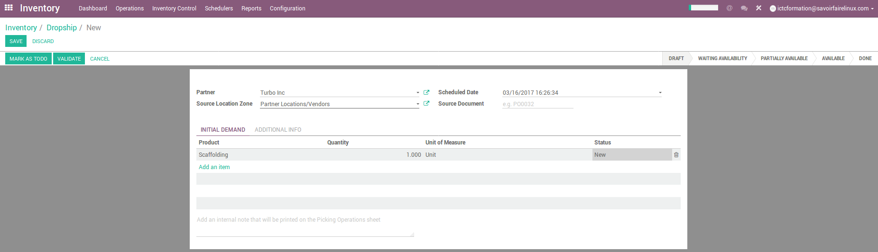
Drop-shipping Confirmation

Slide 50
Inventory Adjustments

Slide 51
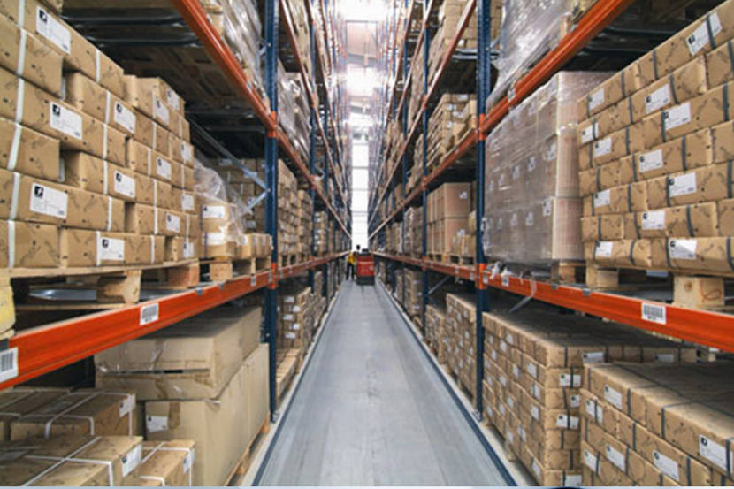
Inventory Level
provide a good Service Customer
have a good Inventory productivity
have a good ROI
accurate accounting of inventory quantities and cost
prevent large year end write-downs
Merchandise inventory just to
Critical point
&
Big assets

Slide 52
Inventory Adjustments
An inventory adjustment is used to synchronize the inventory/stock to account for issues that occur outside the normal business flow (e.g. receipts, sales, stock counts, etc.)
An inventory adjustment impacts the stock ledger as the inventory value for a location is impacted. Ending stock value will be decreased/increased (over-valued or de-valued)
An inventory adjustment item should be a transaction-level item

Slide 53
Types of adjustments
Cycle Count – Adjust quantities when the cause can not be explained.
Defective Loss – Inventory that is damaged and can not be sold or sent back to the vendor.
Obsolete Loss – Item in good condition but not generating any sales volume. It creates a carrying cost. Once items are removed from inventory, physically they are removed from the warehouse.
Inventory Receipt Corrections – Adjust quantity received.
Average Cost – Adjust quantities, incorrect cost, and new cost to enter the correct average cost that needs to be adjusted.
Misc. Adjustments – Donation, Free items, Samples, Sales Promo, Theft, warehouse use.

Slide 54
Exercise : Annual Inventory Cycle Count
20 min
As an annual activity, Canadian Colors wants to do a general inventory count for both the main warehouse and stores.
TO DO
Using the Inventory Adjustment option, generate the annual inventory activity for each warehouse/store by location (e.g WH/General Stcck)
Select if you want to do the inventory for all products or for one product. You must specify the product or category.

Slide 55
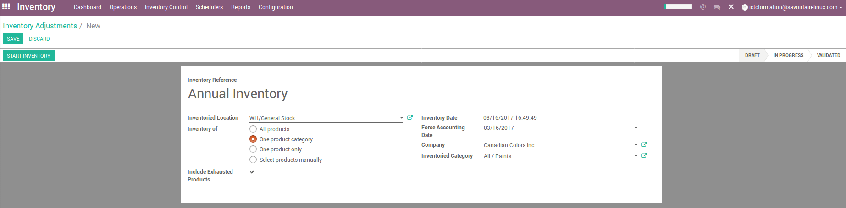
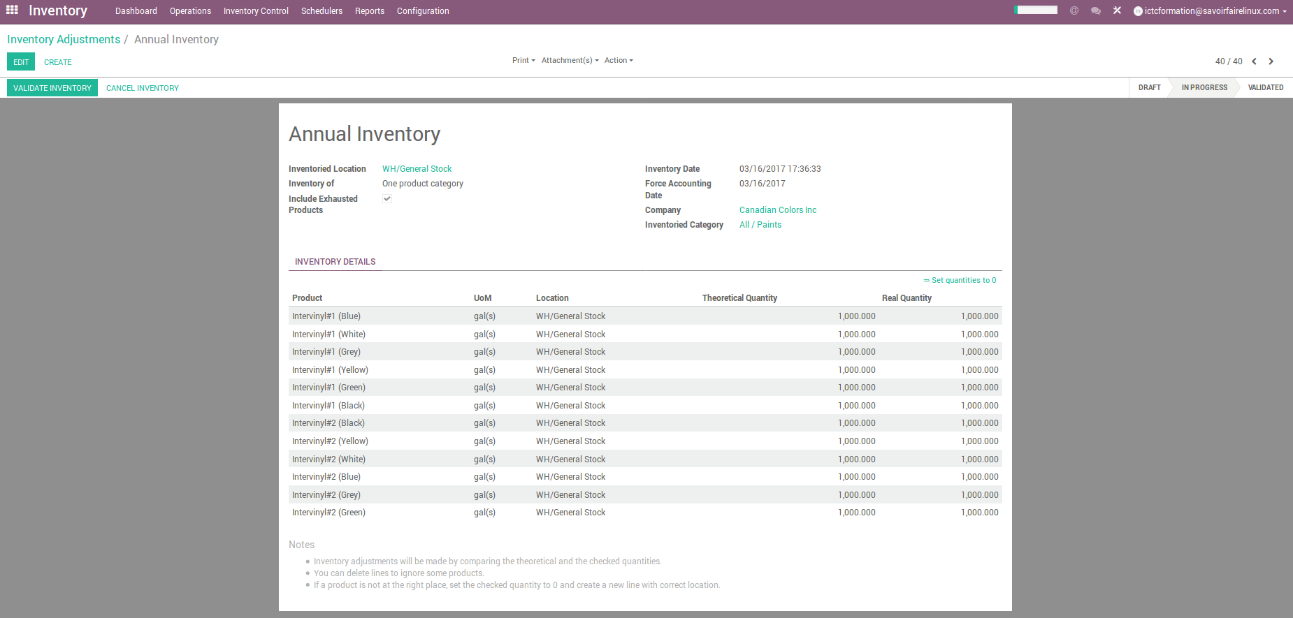
Inventory Adjustments

Slide 56
Contributions
Le présent document a été rédigé et émis par l’équipe de consultants fonctionnels Odoo ERP de Savoir-Faire Linux :
Carolandrea Guerrero
Mickaël Brard
Marc Lijour
Julien Jézéquel-Bréard
Bruno Joliveau
Quentin Lavallée
Adriana Ierfino
Guillaume Lot
Vous pouvez récupérer les documents de formation, les utiliser et modifier (dans les limites des conditions prévues par la licence CC-BY-NC-SA), depuis l’url suivante : https://github.com/savoirfairelinux/training-odoo

Slide 57

Solutions de gestion informatique
LICENCE : CC-BY-NC-SA

